Slide 1
Estimating the Undiagnosed Fraction:
Disseminating the
“Testing History” Method
Martina Morris
Jeanette Birnbaum
Matt Golden
Notes:
Update on this project about …
Notes: just 1-2 slides on backcalculation

Slide 2
Overview
The Method
Summary and assumptions
Applications
Dissemination
Prototype “Rshiny” web app
Your Feedback
Refining the method
Working with stakeholders
King County, WA
Existing R code
WA state
Notes:
Methodology development with explaining TID + our assumptions (3 slides total: TID – with assumptions (graphically show), then backcalculation. 4 panel plot of how assumption of time of infection relates to TID; add another 2 panels to ) -> Propotype web access -> Working with stakeholders

Slide 3
The Testing History Method

Slide 4
Approach: Backcalculation
New diagnoses in 2014…
10 diagnoses observed
Time
2010
2011
2012
2013
2014
1 infection
2 infections
3 infections
1 infection
3 infections
…are based on infections that occurred in the past

Slide 5
Time from Infection to Diagnosis (TID)
10 diagnoses observed
Time
2010
2011
2012
2013
2014
1 infection
2 infections
3 infections
TID = 4 years
1 infection
3 infections
TID = 0 years

Slide 6
Backcalculation’s 3 Components
OBSERVE
BACKCALCULATE
ESTIMATE
Sum ( * )
Cases diagnosed at T
Incidence at X yrs ago
TID
probability for X yrs ago
=

Slide 7
TID from Testing History
Infection window = [Date of last negative test, Date of diagnosis]
1) Get date of last negative test
“Have you ever had a last negative test?”
Yes
No
Missing
Use date provided
Assign age 16 or age-18 years
2 data inclusion options
2) Determine time of infection within the infection window

Slide 8
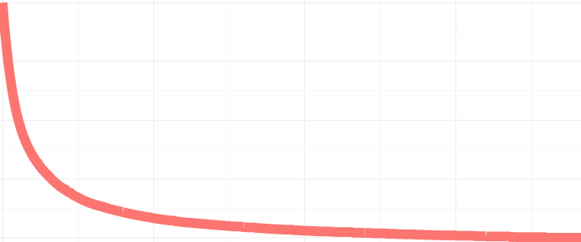
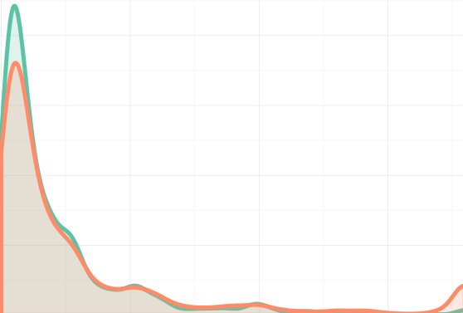

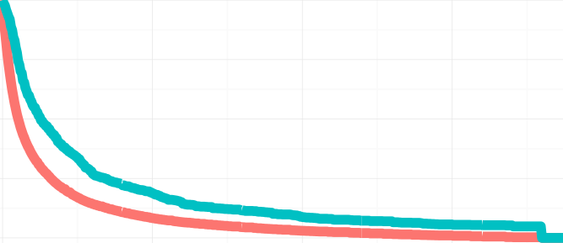
Impact of TID Assumptions on TID
OBSERVED ONLY
UNIFORM
“BASE CASE”
# infections
% undiagnosed
Density of last negative tests
Last neg test
Diagnosis
18 years
AT LAST NEG TEST
“WORST CASE (OBS)”
0 years
18 years
# infections
% undiagnosed
Last neg test
Diagnosis
18 years

Slide 9
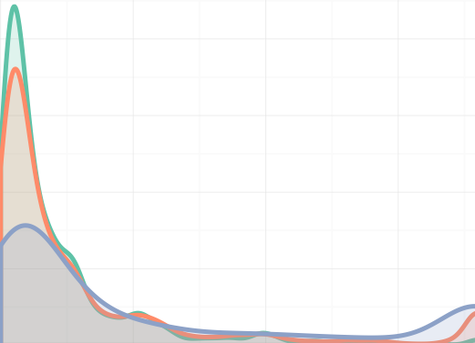

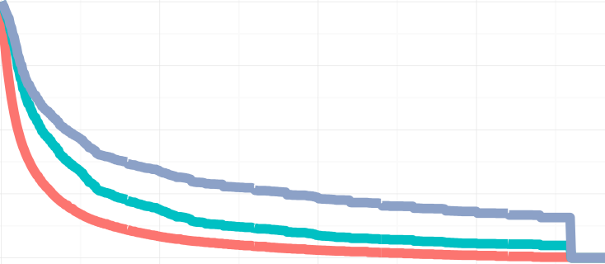
OBSERVED ONLY
UNIFORM
“BASE CASE”
# infections
% undiagnosed
Density of last negative tests
Last neg test
Diagnosis
18 years
AT LAST NEG TEST
“WORST CASE (OBS)”
# infections
% undiagnosed
0 years
18 years
Last neg test
Diagnosis
18 years
INCLUDING MISSING
AT LAST NEG TEST
“WORST CASE (MISS)”
Density of last negative tests
# infections
% undiagnosed
Last neg test
Diagnosis
18 years
0 years
18 years

Slide 10
Applications

Slide 11
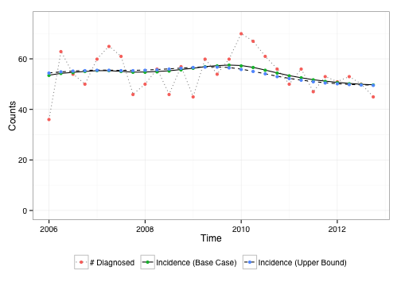
KC MSM: Incidence ~ Constant
15% missing testing history
Notes:
Fairly constant incidence…precede by % missing by race

Slide 12
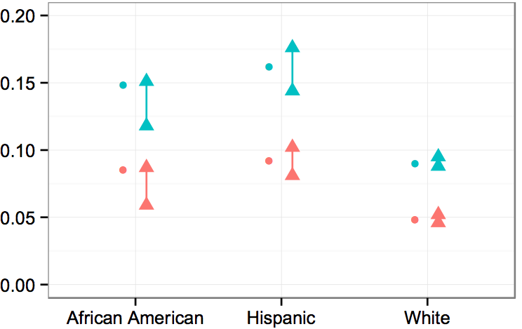


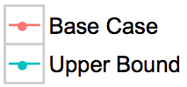

KC MSM: Undiagnosed % Varies by Race

Slide 13
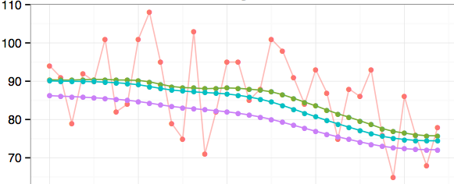



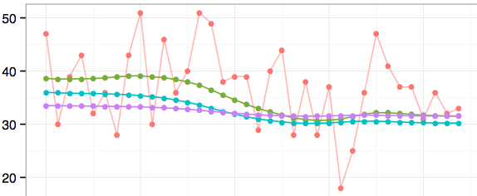

WA: Incidence is Declining
MSM
35% missing
Hetero
60% missing

Slide 14
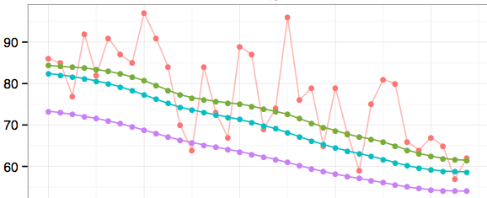
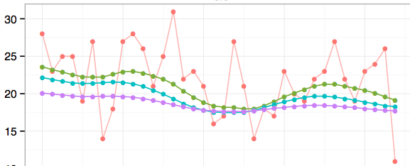
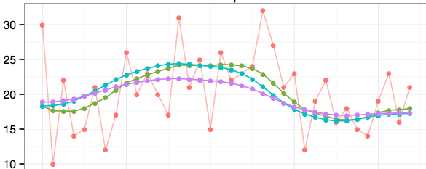

White
40% missing
Black
49% missing
Hispanic
48% missing

Slide 15
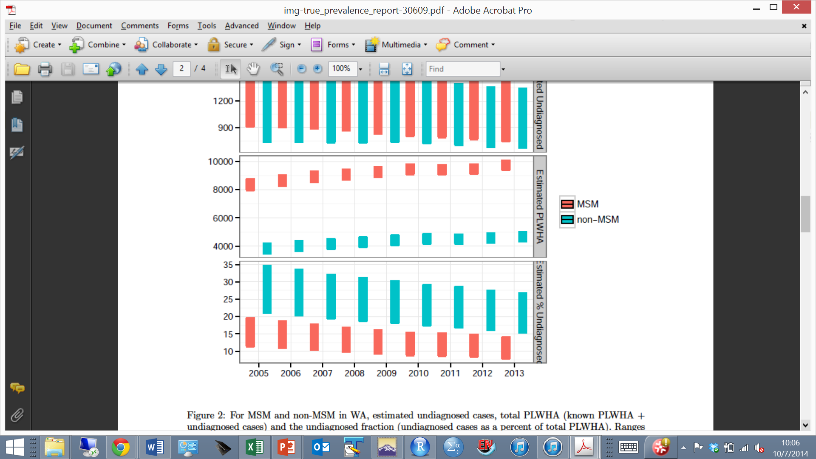
WA state undiagnosed fraction
2013:
MSM: 8 - 14%
Non-MSM: 16 - 27%

Slide 16
Dissemination to Public Health Departments

Slide 17
Code for R users
Format
Standardize variable names and units
Apply assumptions to testing history question
Describe
Sample characteristics
TID under various assumptions
Run
R package “HIVBackCalc”
Summarize results

Slide 18
R package “HIVBackCalc”
Backcalculation functions
estimateProbDist
estimateIncidence
meanEMUpdate
estimateUndiagnosed
Formatting and descriptive functions
Notes:
estimateProbDist: Estimates the discrete time probability distribution function for the time between infection and diagnosis (using the uniform assumption or incidence=at time of last negative test assumption)
estimateIncidence: the backcalculation
estimateUndiagnosed: uses the incidence estimates and the TID again to estimate how many were undiagnosed in each (quarter)

Slide 19
Web Portal
Goals:
Provide self-guided access to model for local use
Minimal learning curve
Minimal pre-processing of data
Outputs presented in most policy-relevant form
Mechanism
“Rshiny” interface

Slide 20
Protoype Rshiny App
https://hivbackcalc.shinyapps.io/HIVBackCalc_App/

Slide 21
Your Feedback

Slide 22
Issues
Data privacy requirements
Local, protected upload, unprotected upload
Detail in outputs
Race, mode, sex subgroup results?
Impact of missing data (suggestions for better assumptions?)
Training for users

Slide 23
Your interest and our availability
Your timeline for trying this?
Data/personnel ready now, or further in the future?
Our availability
Jan to mid Feb
Primarily R code support
June
Further development of Rshiny web portal
Support for interpreting results

Slide 24
Thank you!

